Slide 1

Data Wrangling – Enter the Tidyverse

Slide 2
Why does our data need to be tidy?
Using messy data will may make conducting your analyses to be impossible. Or worse yet, it may give us misleading results!
This is because R needs to be able to read and understand our data to work with it – having tidy data makes it easier for us humans to communicate our needs to R.
R is like a robotic toddler – it will shout “error” or “warning” if things are not just right.
Likewise, R will also assume that everything is provided is 100% correct and intentional… This can cause reliability problems if we’re not careful.
Tidying our data makes our programming easier, facilitates our analyses, and increases the reliability of our work.

Slide 3
Examples of messy data
Continuous numeric variable coded as a character (i.e, 1 = “1”, or 1 = “one”). R will get upset and won’t run your analysis, as you’ll be asking it do something it finds to be impossible..
Having categorical variables labelled as numeric (i.e., different schools given number codes, which are in turn treated as a continuous integer). R will give you nonsense if you were to control for the variable in the analysis.
Having multiple values stored in one column – You’ll be asking R to do 1 thing with these two separate pieces of information. Poor R will get confused.
Dates and times are very tricky – especially due to global inconsistencies in formatting (** cough, cough USA).
Data might be in the incorrect unit (i.e., data might need to be changed from imperial to metric).
Having multiple columns for the same variable – aka in a “wide” format. R will treat each column as a separate variable, and it cannot understand why in some cases this might not be the case (i.e, repeated measures).
There are cases where “wide” might be useful, but overall, your coding work will be easier in the long format. Thankfully, R makes it easy to switch between these formats.

Slide 4
What does it mean for our data to be tidy?
Tidy Data Formatting
Each variable is correctly specified.
Each variable has its own column.
Each row represents an individual data point (check phrasing).
Each row within each column is dedicated to one value of data.
Ensure our data is consistent (i.e., spellings of country names).
Tidy Data hygiene
Our values are meaningful (i.e., bots are removed, value ranges and patterns are “realistic”).
Removing inappropriate participants (i.e., removing participants that did not meet study inclusion criteria).
NA’s have been dealt with appropriately.
Data has been appropriately transformed if needed (i.e., log transformation for exponential data, mean-centering for interaction analyses).
All calculations required for analyses (i.e., total scores) have been done.
Dates have been dealt with
Notes:
I’m avoiding outliers… as this is a topic of debate! But it is also complex – your outliers may be a feature of the data (if data is exponential, a log transformation will make sure the outliers do not bias the analysis).
Remove unrealistic values (i.e., if participant scored 100% for every question, including contradicting questions, that participant’s data needs removing).
Otherwise, you need to check if the outliers are influential on the analysis, and/or apply robust methods adjustments to the analysis to account for their effect.

Slide 5
Benefits of tidy data skills
Opportunity to build your coding skills!
Allows for speedy reproducible and inter data preparation.
Increases the reliability of our work.
Facilitates our data analysis and data visualisation – by formatting the data into the tidy structure, it makes it easier to command the computer to obey our research whims!
The processes work hand in hand with exploratory analyses, which allow us to gauge the structure of our data pre-analysis.

Slide 6
Tidy data tips:
Leave the raw data in its raw form – R allows us to make new objects, so we can be confident of our raw data being safe and untouched.
Play around! We can always refresh data/steps if needed. Data tidying is a great space for building our knowledge of coding.
# use comments – Comments can be used to remind us what we’ve done, and to help us navigate our workflow.
Break it down into chunks/steps – I like to work with formatting steps first, and then with data hygiene.
Do what you can – Not everything needs to be done in R, and some steps may complicated/time demanding. We can save our data at any point to be uploaded elsewhere.
But be aware that every step done in R can be easily reproduced and updated. Any calculations or filtering is very easy in R. Every step you make is a time saving investment for future you.

Slide 7
Key tools of tidy data
Tidyverse is our power house. It contains a multitude of packages all designed to facilitate our data tidying.
These include:
dplyr (aka – data pliers) . It contains a variety of useful functions to help select our data (i.e., `select()`), change our data (ie., `mutate()`), and choose our data values (i.e., filter).
The pipe! `%>%` or `|>`. This is an amazing little tool that allows us to combine commands in R. It makes our code readable, and allows to achieve more complex commands.
PIVOT!! We can use pivot functions to switch our data between “long” and “wide” functions.

Slide 8
Missing data
This is a complex area of discussion, and very much a “dammed if you, dammed if you don’t!” aspect of any analysis.
Long story short – some analyses won’t work if there’s missing data present, but… removing missing data can bias our analysis if there’s reason for why data is missing.
Additionally, removing missing data will reduce the power of our analyses – this can lead to a type 2 error (False negative) if it leads to severe reduction in rows.
In many cases, imputing data will help to improve the reliability and power of our analyses. But it needs to be done carefully.
This is too complex to cover today, but for anyone who wants more information on handling missing data, useful resources have been provided in the “notes” section of this slide.
Notes:
Enders book, naniar resources, Much ado about Nothing, MICE

Slide 9
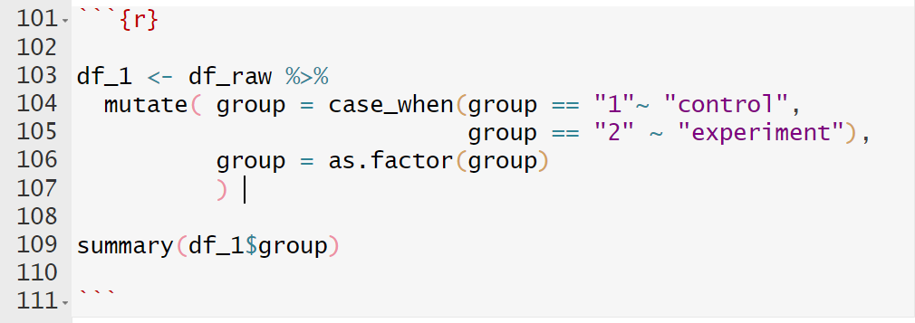
Let’s get coding!

Slide 10



Code cheat sheets
https://www.rstudio.com/wp-content/uploads/2015/02/data-wrangling-cheatsheet.pdf
http://www.flutterbys.com.au/stats/downloads/slides/figure/factors.pdf
https://posit.co/resources/cheatsheets/

Slide 11
Useful reading
Wickham, H. (2014). Tidy data. Journal of statistical software, 59, 1-23. https://vita.had.co.nz/papers/tidy-data.pdf

